Slide 1



Social skills, what does it mean.
The importance of interpersonal skills in professional life.
The “MiGreat Project”- n. 2016-1-IT01-KA202-005348 has been funded with support from the European Commission. This document reflects the views only of the author and the Commission cannot be held responsible for any use which might be made of the information contained herein.
eLearning Studios

Slide 2
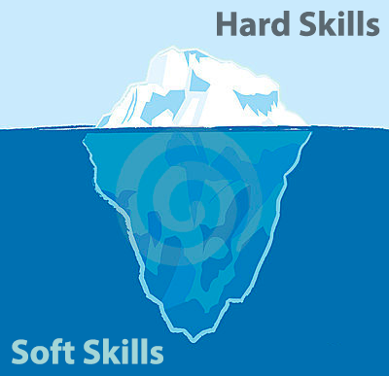
Objectives
To learn about soft skills
To identify the different profile of skills and the areas of interpersonal dimension
To recognize soft skills in own life
To apply soft skills in working life
To have initial grasp on how interpersonal skills contribute to good working relationships as well as overall performance

Slide 3

What are soft skills?
Soft skills - unlike hard skills, which are measurable and can be proven - are intangible and difficult to quantify. Nonetheless, they are crucial in a job search and in overall professional careers. Soft skills are more connected to who people are, rather than what they know.
One reason soft skills are so revered is that they help facilitate human connections such as building relationships, gaining visibility, and creating more opportunities for personal and professional advancement.
Notes:
Answers might include things like:
What the person looks like, whether they look happy or bored with your answers, if they seem interested in you, if they seem like the kind of people you would like to work with, how formal or informal they are, if they are making gestures to others, body language and gestures to give clues as to how well the interview is going.
Conclusion: When meeting face to face there is a lot of information you are giving to one another that is important. Being able to read body language can help give you clues as to what to do to make a more positive impression and can help build rapport.

Slide 4

What are soft skills?
In this sense, the term describes those personal attributes that indicate a high level of emotional intelligence.
Thus, Soft skills can be:
social (communication-based)
organisational (strategy, innovation capacity)
technical (specific abilities for different sub-sectors)
creative/artistic (specific talents for different sub-sectors).
Notes:
Have you every been standing a train station where you knew a train was about to coming rushing through and not stop and even though you see and hear it I in advance you still flinch when it passes through? You know it isn’t going to harm you and yet it can it can still feel terrifying. Have you ever wondered why?
The truth lies behind the fact that we have 3 brains…

Slide 5



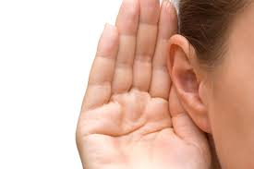


What are the soft skills in daily life?
List of soft skills:
Verbal communication: what we say and how we say it.
Non-verbal communication: what we communicate in other ways except using words
Listen skills: how we interpret the verbal and non-verbal communication and messages sent by others
Negotiation: working with others finding a mutually agreeable outcome which shall make both parts satisfied
Leadership: how we influence and guide people in our life and working environment

Slide 6

What are the soft skills in daily life?
Problem solving: working with others to identify, define, and effectively solve problematic issues
Decision making: exploring and analyzing options to make sound decision
Stress and time management: how to deal with tasks and duties so that they will be delivered in a proper ways, on time, and without creating too much pressure on someone’s mind and behavior

Slide 7

What are the soft skills in daily life?
Networking connection building: what to do and how so as to create a cooperative support among people and organisations which respond to needs at due time
Flexibilty/adaptability: adjusting and coping with issues and situation, in many cases not foreseen, in such a way to achieve goals anyway
Intercultural awareness and sensitivity: feeling and dealing with differences related to cultural matters

Slide 8


What are the soft skills in daily life?
Teamwork: the way we organise, share, delegate, and implement tasks in a cooperative/complementary way with others.
Assertiveness: communicating our values, ideas, beliefs, opinions, needs and wants freely
Overall emotional intelligence can considered the “summarising” element of human beings in relation to interpersonal skills: it can be defined as the measure of an individual’s abilities to recognise and manage their emotions, and the emotions of other people, both in individual and group situations.

Slide 9

ACTIVITY
Go through the listed soft skills of Slide 4-7 and evaluate (from 1 little to 4 very much) the level of acquisition of each skill in your personal life.
Identify the ones you are stronger (and be proud) and the ones you might be weaker (so as to strengthen them).

Slide 10

How are interpersonal skills relevant to professional life? (from Soteris Phoraris)
Some good reasons to consider soft skills relevant on your job:
Fostering Effective Communication
Interpersonal skills are necessary for the establishment of relationships between yourself and fellow workmates, which leads to a mutual exchange of ideas, information and skills.
You establish mutual respect and consideration for one another’s opinions and input.
Communication conducted in this manner enables the performance of duties, management of tasks and completion of assignments.

Slide 11

They Expand Your Opportunities
Through connections with managers and fellow workmates you can make a good impression on colleagues, they’ll be in a position to give you good references or even bump you up to a higher position with more responsibilities and perks, which is an advantage for your professional development.

Slide 12

They Make You Relatable
With good interpersonal skills, your colleagues and your managers positively perceive you as an approachable person.
Coworkers are more comfortable interacting with you when seeking your assistance and advice.
You’ll find that people become easier to work with, and you can engage with them more meaningfully, making your productivity more fruitful.

Slide 13

They enable you showing Social Awareness
Your interpersonal skills show when you have an interest in the well-being of co-workers and customers, and their best intentions at heart, gaining their trust and confidence.
A keen sense of perception helps you through various social situations, for instance, where you’re required to work as a team. It also helps you make the right judgment calls and decisions about sensitive work-related issues.

Slide 14

THey make you Foster and Maintain Personal Relationships
Interpersonal skills become much more effective, beneficial and rewarding when they foster meaningful relationships.
Not only is it important to build personal relationships in the workplace, but it is also important to maintain these relationships within professional boundaries.
The best way to maintain interpersonal relationships in the workplace is to make them sincere.

Slide 15

They Make You an Effective Leader
If you take a look at most lists or articles which talk about interpersonal skills in the workplace, the titles could’ve been easily “Characteristics necessary to be an effective leader”.
A leader without the ability to connect with his/her team will inevitably fail, or lose valuable members of that team resulting in the loss of productivity or burdening other employees with the work left behind.

Slide 16



Soft skills applied in professional life
ACTIVITY
Try to find at least other two good reasons where soft skills in personal life might be helpful, rewarding, productive, and successful in professional life, i.e. in your working environment.

