Slide 1
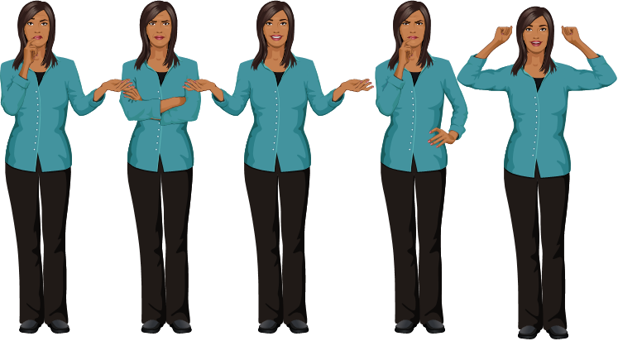


Body Language &
PRESENTING a POSTIVE IMAGE
eLearning Studios

Slide 2
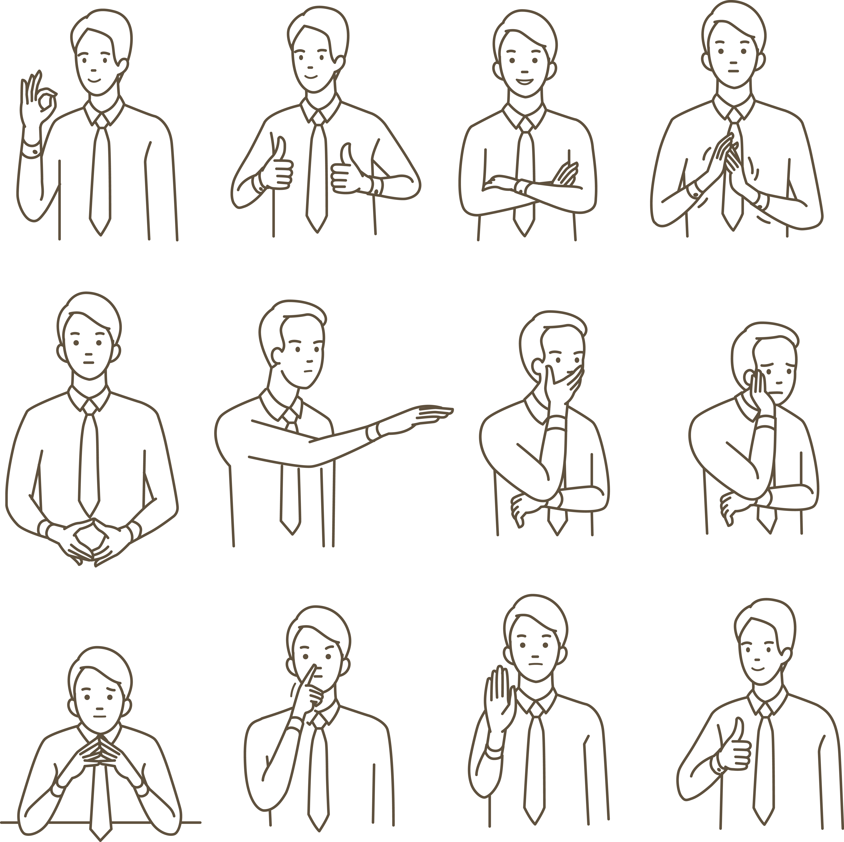
Objectives
To understand the power of body language
Be able to understand basic body language gestures
Building rapport and understanding the principles of mirroring
Presenting a positive image and your personal brand
Presenting a positive image at interviews.

Slide 3
The Power of Body Language
In the first few minutes of meeting someone in person you start to form an opinion of them based on these first impressions.
Question: What information are you missing if you have an interview on the telephone compared to a face to face interview?
We use body language every day to communicate information about ourselves and to get what we want from other people. But…
We are often not aware of it!
Adapted from research by social psychologist Albert Mehrabian
Notes:
Answers might include things like:
What the person looks like, whether they look happy or bored with your answers, if they seem interested in you, if they seem like the kind of people you would like to work with, how formal or informal they are, if they are making gestures to others, body language and gestures to give clues as to how well the interview is going.
Conclusion: When meeting face to face there is a lot of information you are giving to one another that is important. Being able to read body language can help give you clues as to what to do to make a more positive impression and can help build rapport.

Slide 4
The Power of Body Language
ICEBREAKER ACTIVITY
Notes:
Overview :
Body language speaks louder than any words you can ever utter. Whether you’re telling people that you love them, you’re angry with them, or don’t care less about them, your body movements reveal your thoughts, moods, and attitudes. Both consciously and sub-consciously your body tells observers what’s really going on with you.
Time / 10 minutes
Instructions and set up :
1. Explain to the group that you are going to give them a series of instructions, which you would like them to copy as fast as they can
2. State the following actions as YOU do them:
• Put your hand to your nose
• Clap your hands
• Stand up
• Touch your shoulder
• Sit down
• Stamp your foot
• Cross your arms
• Put your hand to your mouth – BUT WHILE SAYING THIS PUT YOUR HAND TO YOUR NOSE
3. Observe the number of group members who copy what you did rather than what you said.
What's the point from this activity ?
Facilitate discussion on how body language can reinforce verbal communication, however it can also be stronger than verbal communication – it is important that we are aware of our body language in order to ensure we are projecting the right message.

Slide 5
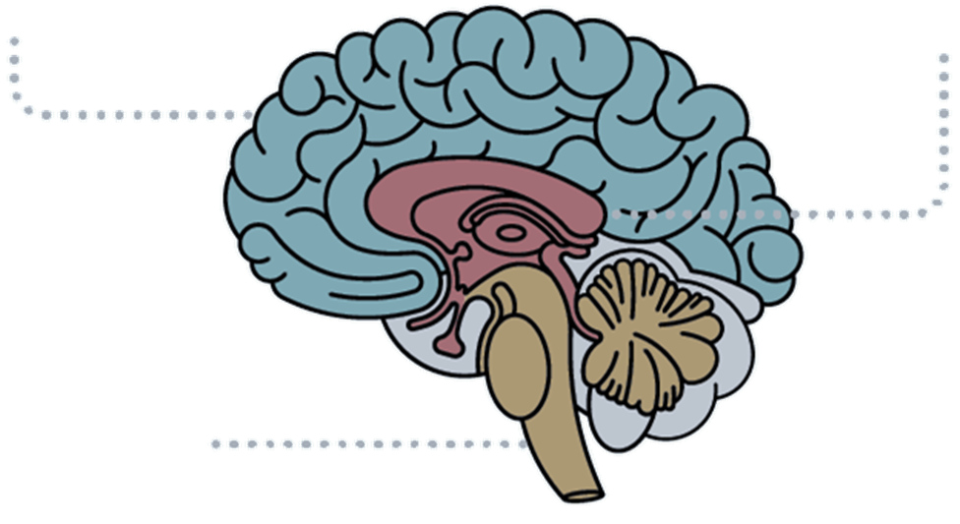
The 3 Brain's
It is believed we actually have 3 brains in 1:
THE REPTITLIAN BRAIN: Responsible for basic survival needs e.g. hunger, temperature control, ‘fight or flight’ fear responses.
LIMBIC BRAIN: We share this other mammals such as horses, dogs and cats. This brain is responsible for feelings and emotions.
NEO-CORTEX: This is the largest layer, sometimes known as the ‘higher brain’. This brain allows us to rationalize and use logic to make decisions.
DECISION MAKING
NEO-CORTEX
EMOTION & MOTIVATION
LIMIC BRAIN
INSTINCTS
REPTILIAN BRAIN
Notes:
Have you every been standing a train station where you knew a train was about to coming rushing through and not stop and even though you see and hear it I in advance you still flinch when it passes through? You know it isn’t going to harm you and yet it can it can still feel terrifying. Have you ever wondered why?
The truth lies behind the fact that we have 3 brains…

Slide 6
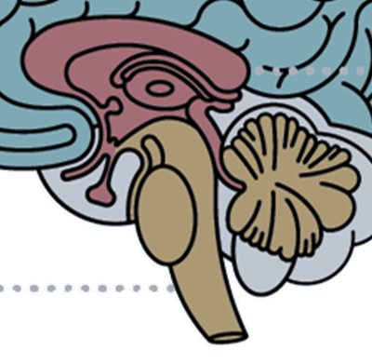
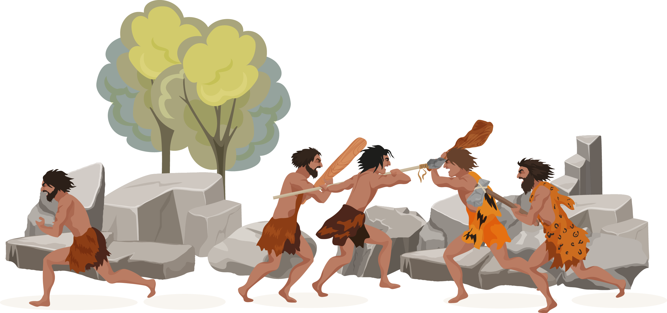
The ROLE OF OUR PREHISTORIC BRAINS
FIGHT!!!!
No way! I’m out of here!
Notes:
Thousands of years ago humans were exposed to dangers on a regular basis. Their main jobs were to hunt, gather and mate.
When in danger humans had 2 responses either to run or fight , we call this the ‘fight or flight response’ and there was only a second or two to make the decision.
The limbic and reptilian brains helped human beings survive by working together and using reflexes. Overall we don’t have much control over our physiological responses or these first 2 brains.
In more modern times we have learned to use our Neo-cortex brain to help us supress our emotions in certain situations.
Imagine you are involved in a heated argument with another person, your more primitive brains could sense danger and make you feel uneasy. Your logical Neo-cortex brain knows you are probably not going to be harmed and that the ‘fear’ you sense is probably not real so the ‘fight or flight response’ is not needed.
Because of our primitive brains it is almost impossible to supress our physiological responses and impulses.
No matter how hard we try we will always make certain gestures that give away our true feelings and thoughts.

Slide 7
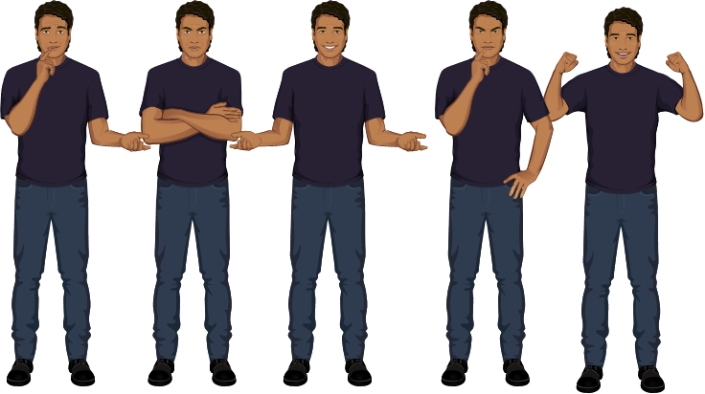
Body Language Elements
Notes:
Now let’s start observing different body language elements used by people in different scenarios….

Slide 8
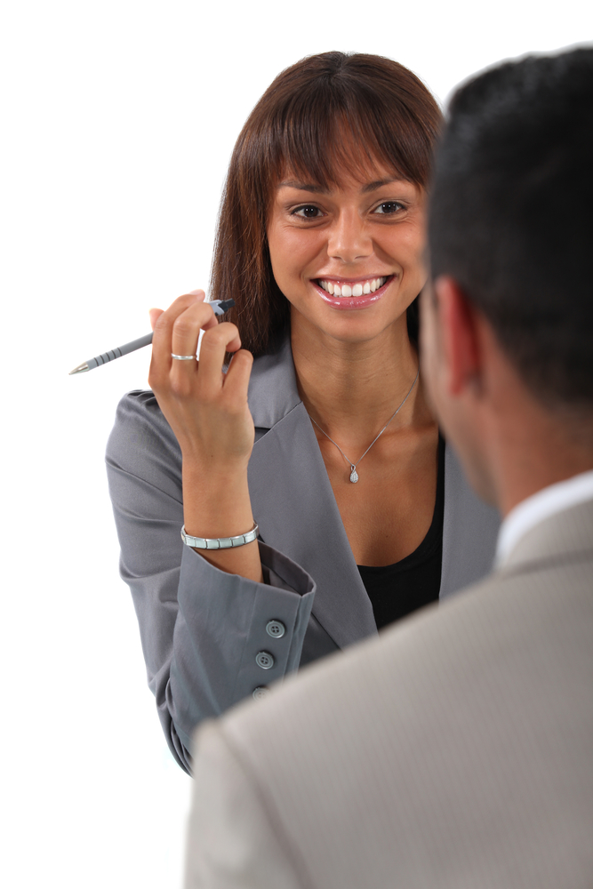

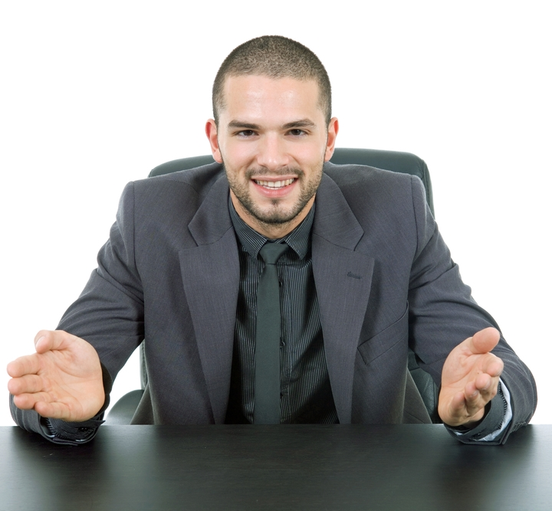
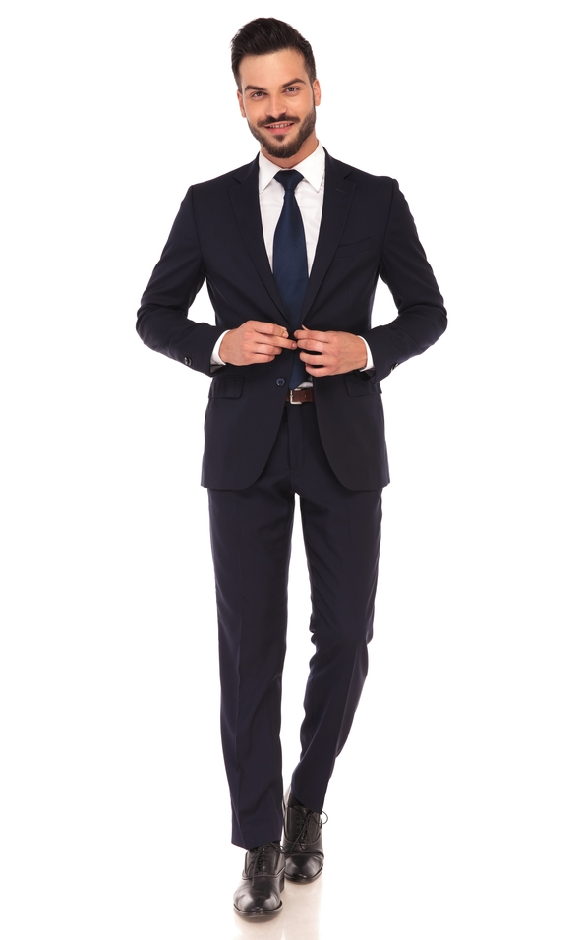
Recognising if someone is interested in you
Making eye contact at least 60% of the time
Eyes wide open
Smiling frequently
Leaning forward
If their hand is touching the lower part of the face this can mean they are evaluating
Their arms are open
Their head is inclined forward
Any head movements that resemble nodding
If they unbutton their jacket it’s a sign of friendliness and willingness to work with you
Feet pointing towards you
Notes:
If you are going for job interview or speaking to an audience its important to know if they are interested in what you are saying or doing.
Even if you feel you are performing well it doesn’t necessarily mean you are getting your message across or answering the questions in way that will get you’re the job.
If you have the ability to recognise that someone isn’t interested then you can quickly make some adjustments.
So let’s first have a look at some gestures that can demonstrate that someone is interested.

Slide 9
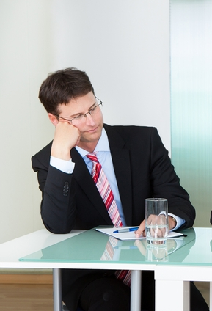
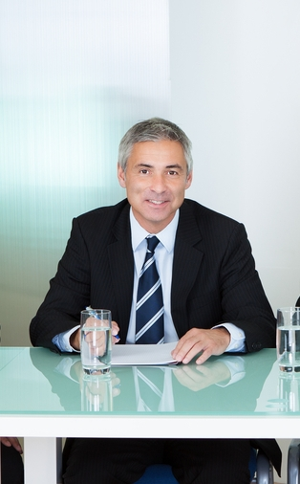
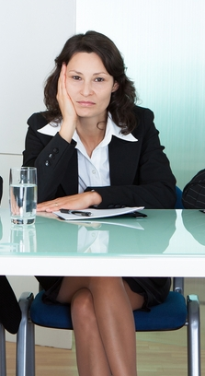
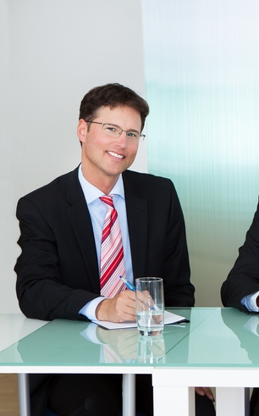



So who do you think is interested and who is bored?
A
B
C
D
E
Notes:
Discussion to decide whose body language is displaying signs of boredom and interest and why.
What other signs are there of boredom?

Slide 10
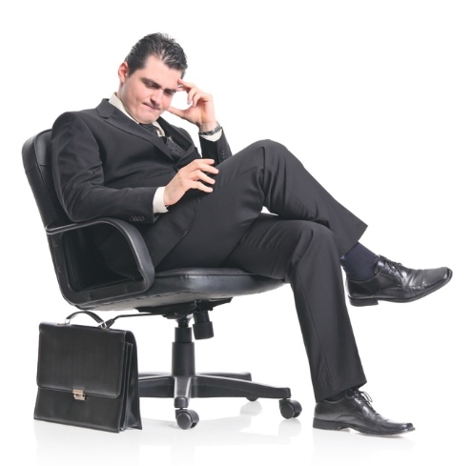




SIGNS OF FRUSTRATION
Rubbing hands on the legs
Scratching or rubbing the hair or back of the neck
Moving the lips up and down whilst keeping their lips tightly closed
Bending the head down and up quickly
Folding and unfolding the arms

Slide 11
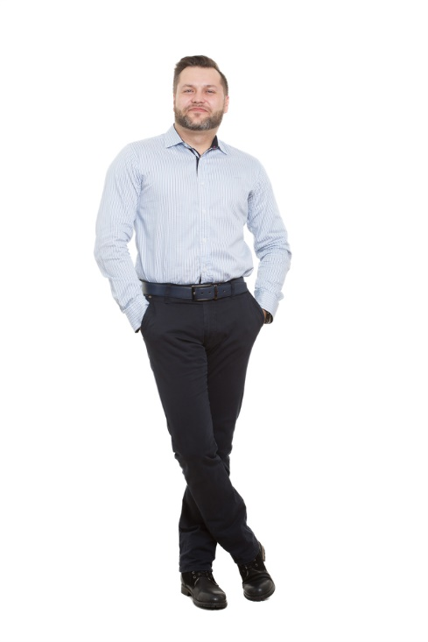
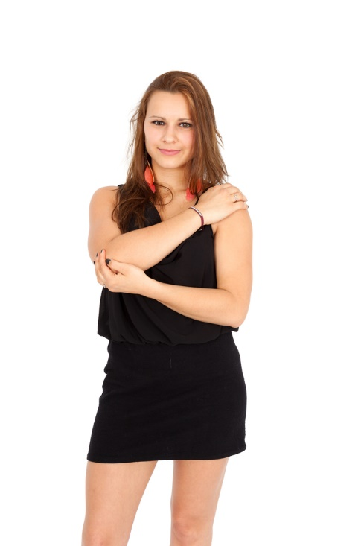
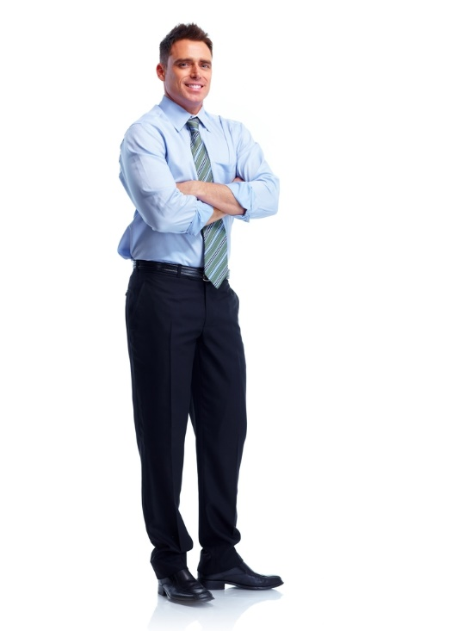
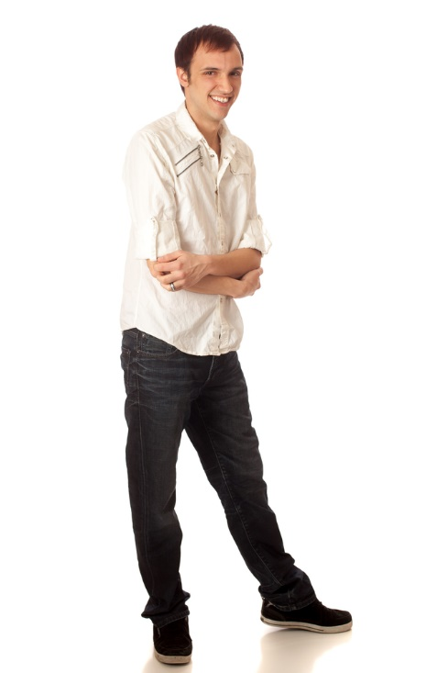
SIGNS OF FEELING DEFENSIVE
Hands in pockets
Trying to hide their arms in any way
Crossed arms
Pay close attention to their feet as they will always be pointing to the nearest escape route

Slide 12
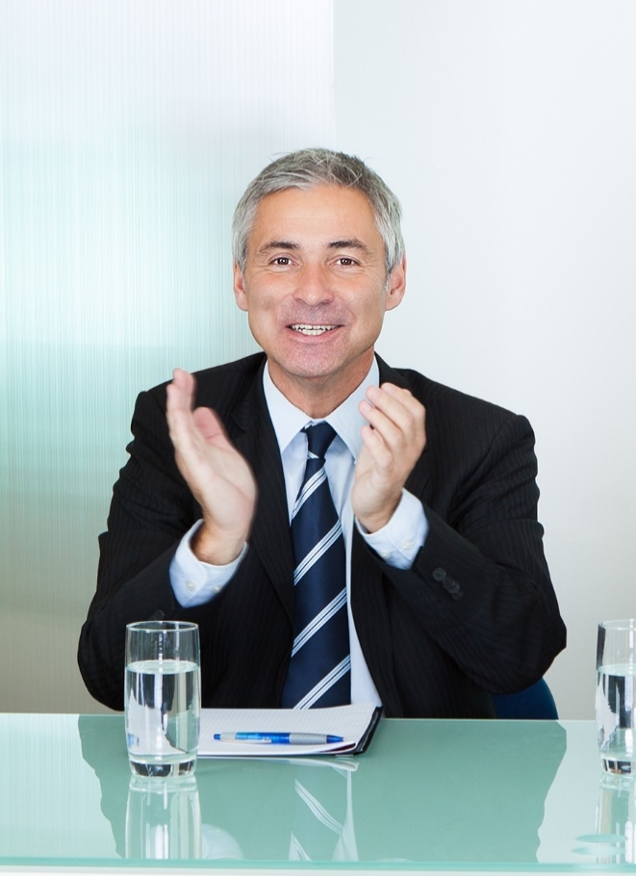


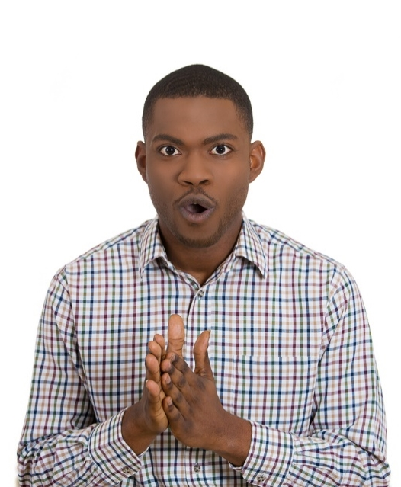
SIGNS OF FEELING excitement & Interest
Clapping hands
Head tilted forward
Fingers crossed
Rubbing palms together

Slide 13
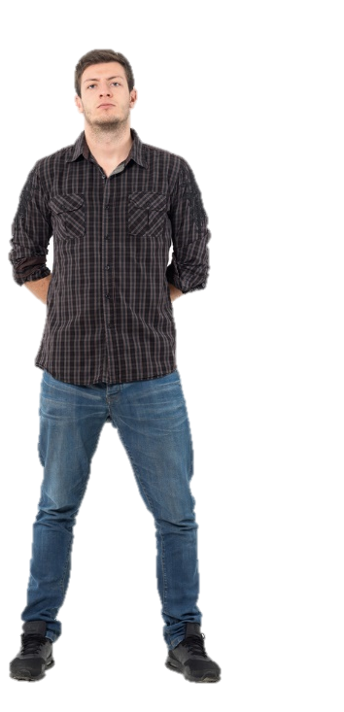
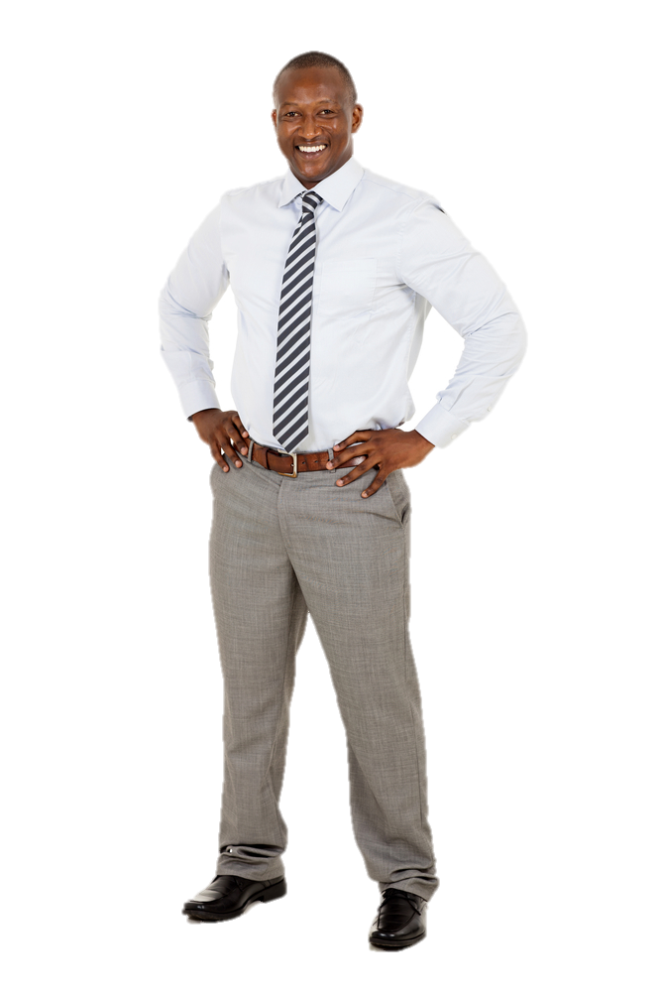
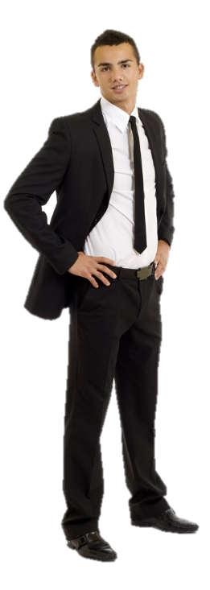
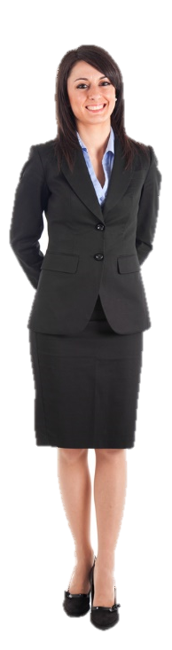
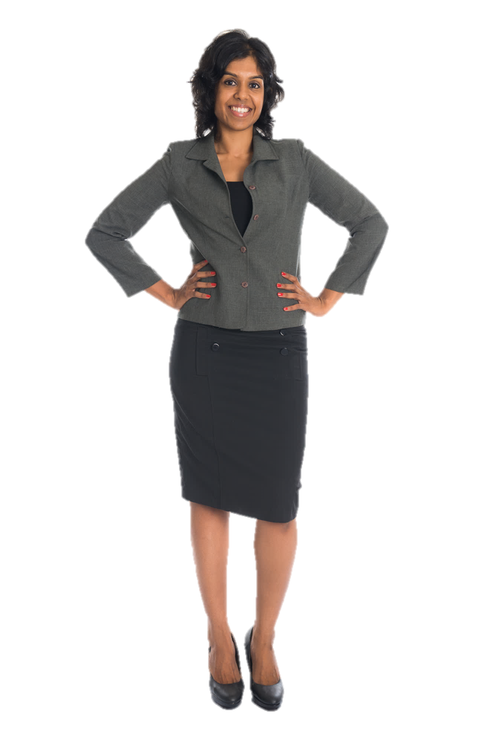
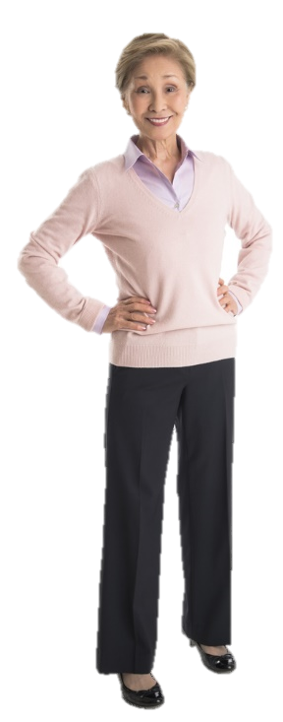
INDICATORS OF CONFIDENCE AUTHORITY & POWER
Constant eye contact
Moves with precision and almost never hesitates
Chest usually protrudes forward
Chin slightly tilted upwards
Hands clenched behind their back
Hands resting on their hips
Leaning back with their hands supporting the backs of their heads
Whilst walking around often swing their arms making themselves look more forceful

Slide 14
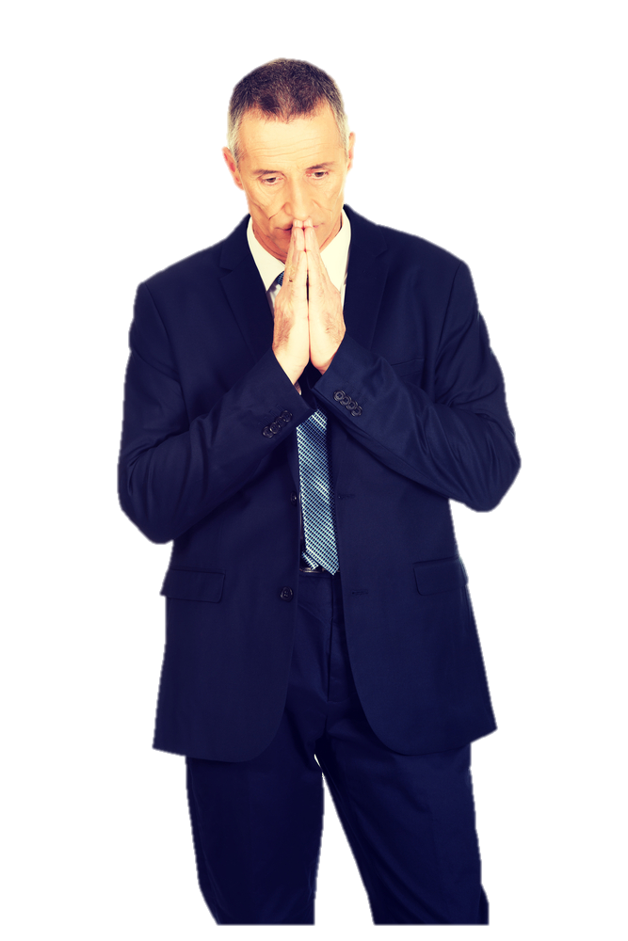
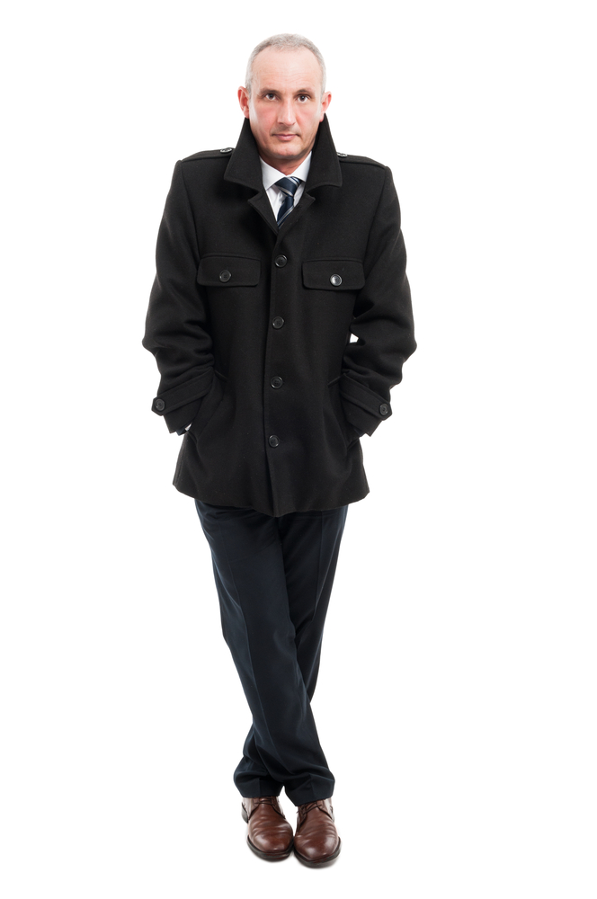


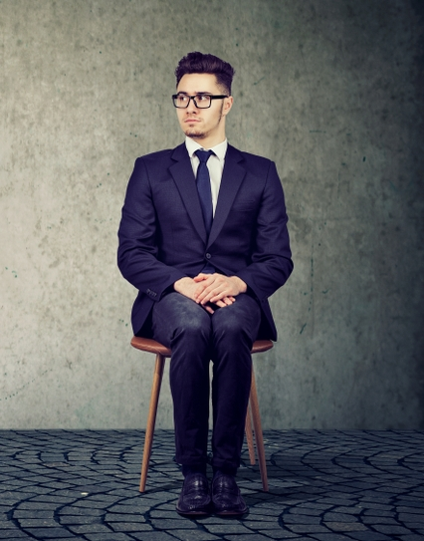
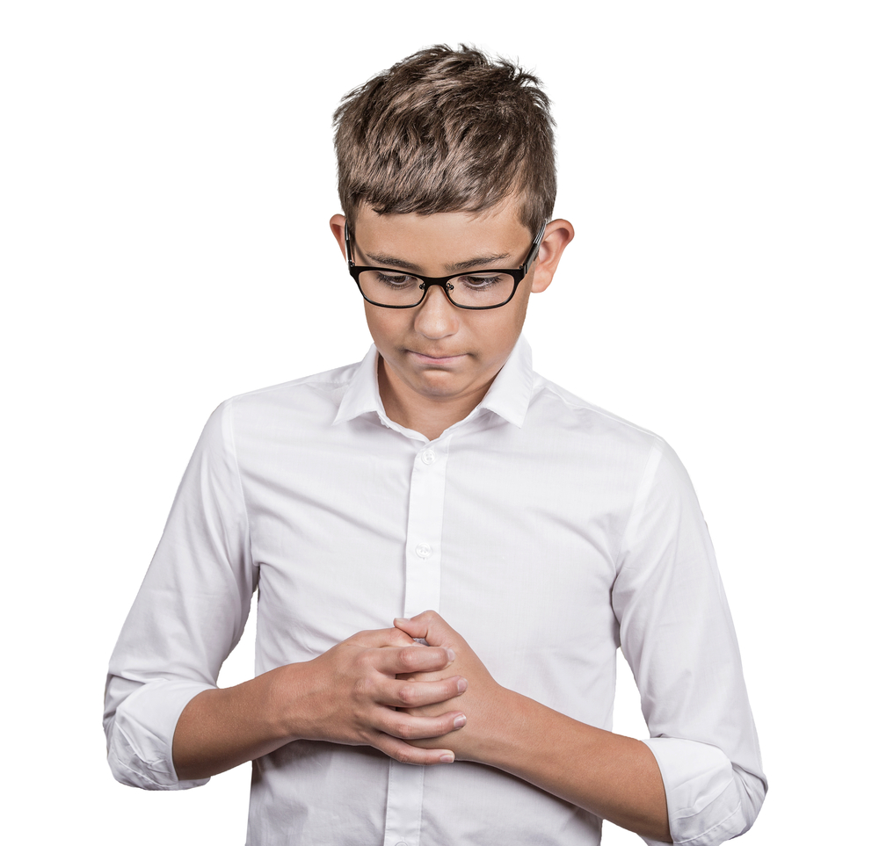

SIGNS OF NERVOUSNESS AND TENSION
Clenched fingers (like praying)
Interlocked hands while pressing against each other
Tapping off feet
Speaking in a high pitch voice with a fast pace. Jittery or stuttering noises
Constant swallowing, coughing and clearing your throat
Arms crossed while gripping the biceps
Crossed legs while standing
Soft handshake with your palm facing up.
Little or no eye contact
Tightly locked ankles.

Slide 15
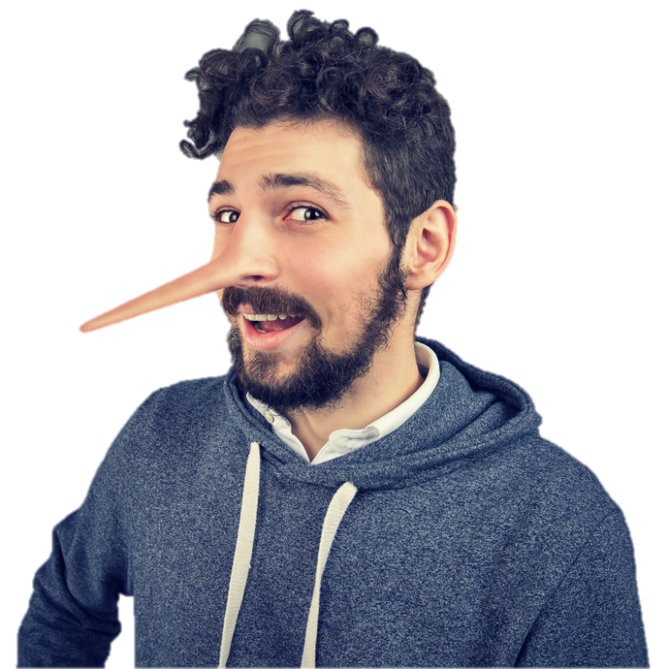
SPOTTING WHEN SOMEONE IS LYING
Discussion Question:
How would you know if someone was lying?

Slide 16
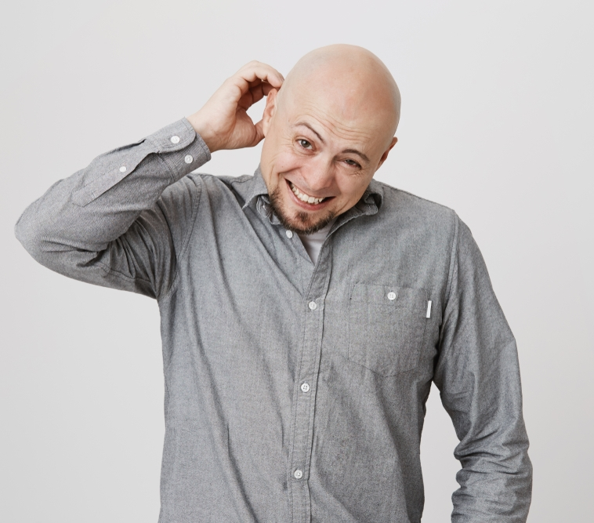
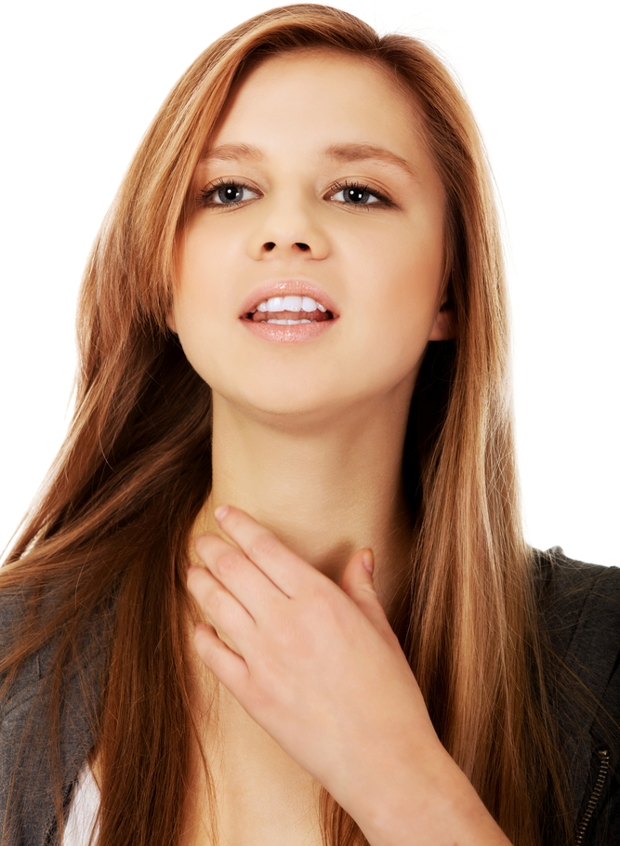
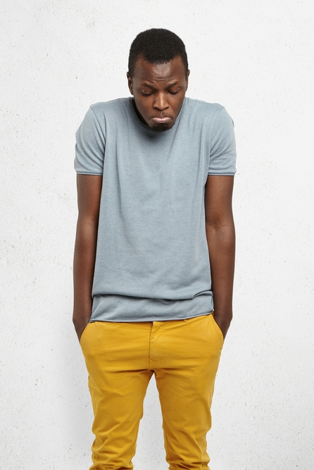
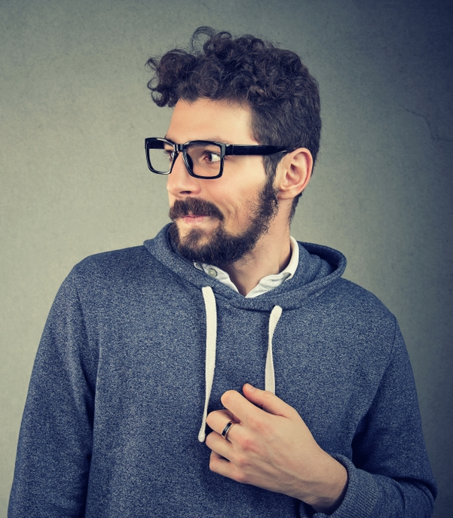

INDICATORS WHEN SOMEONE COULD BE LYING
Speaking in a high pitch voice with a fast pace. Jittery or stuttering noises
Constant swallowing, coughing and clearing your throat
Constantly licking their lips
Blinking repeatedly
Arms crossed at chest level
Rubbing the throat
Constantly touching the face, in particular covering the mouth, nose or ears
Scratching their head or back of the neck
Tapping the hands or feet
Tendency to look down and shrug their shoulders
Constantly shifting and changing poses

Slide 17
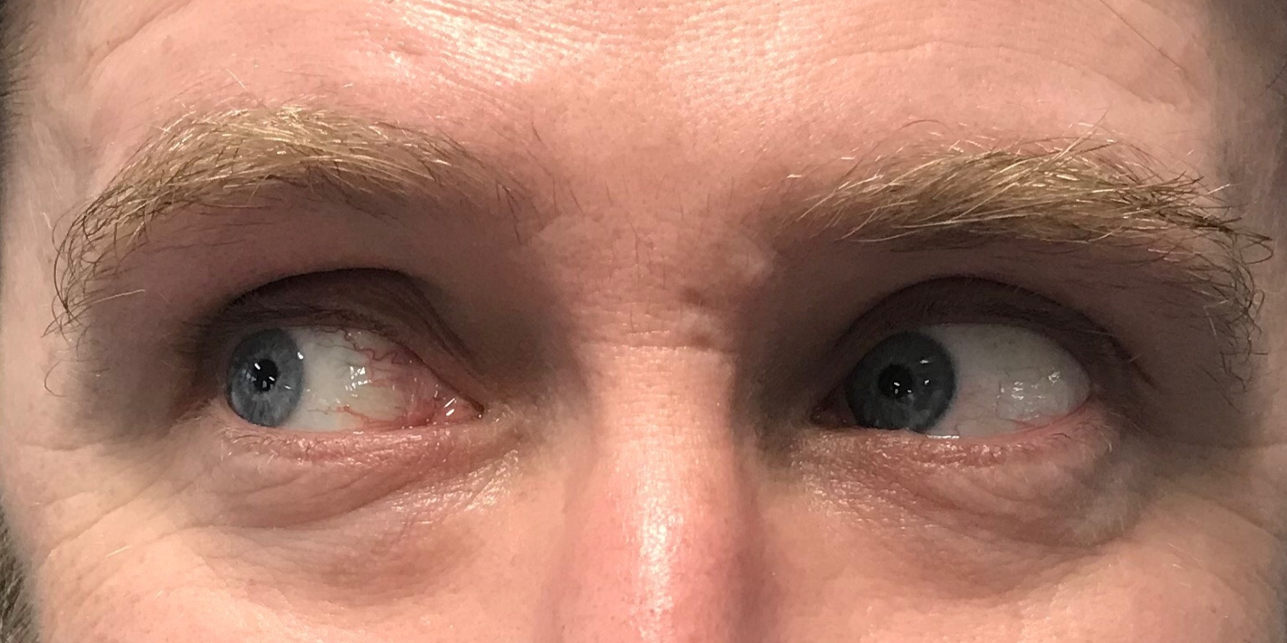
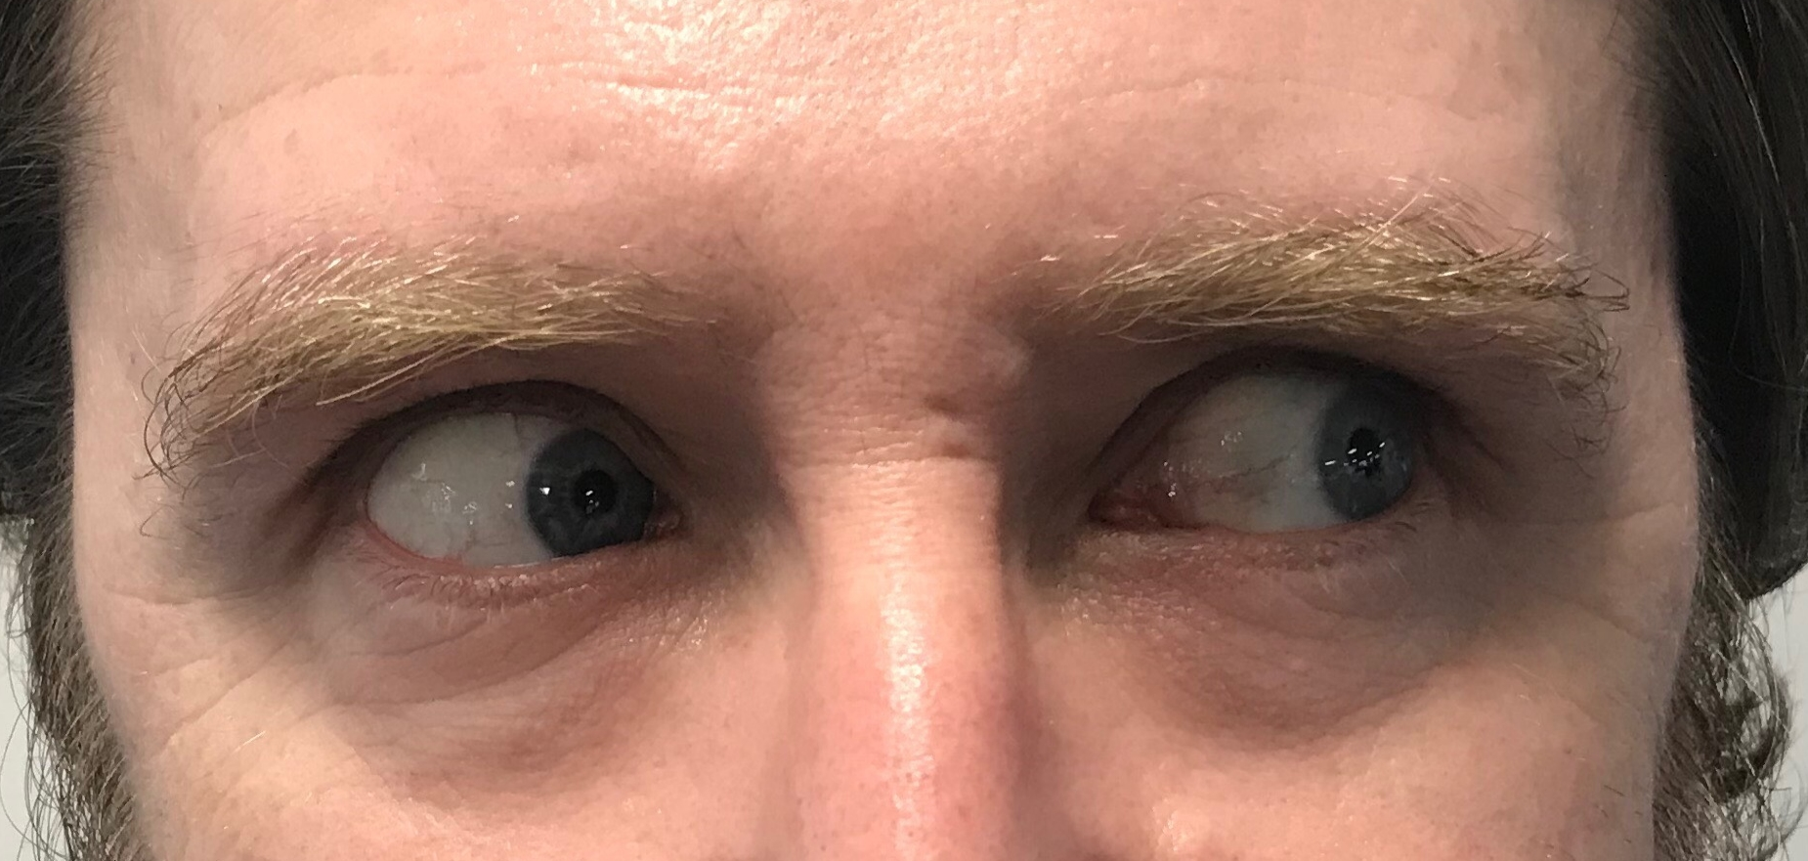
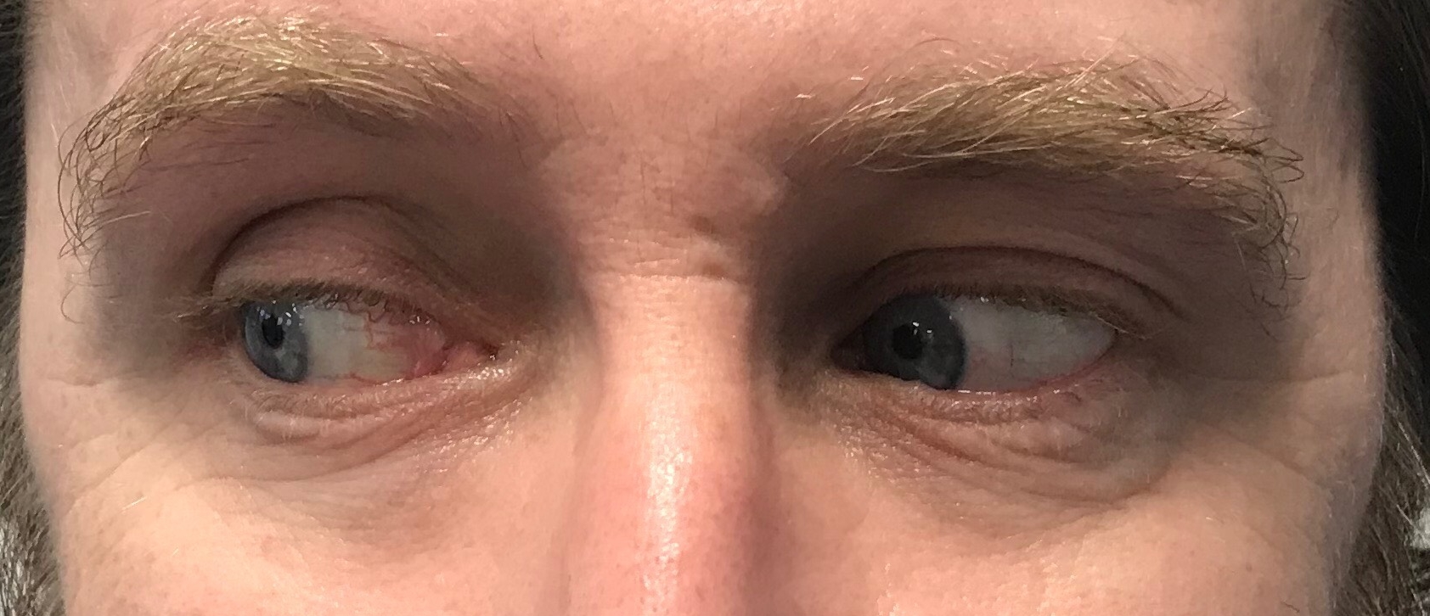
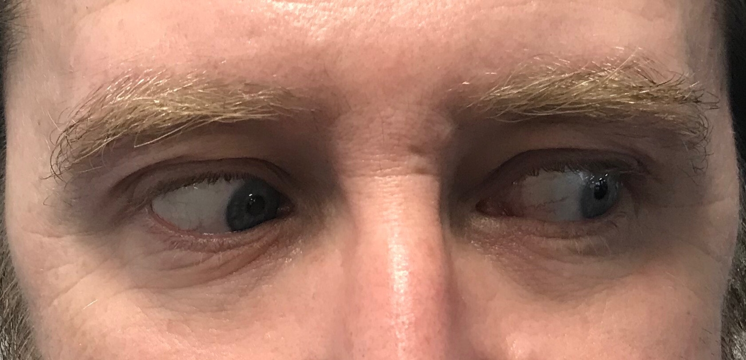
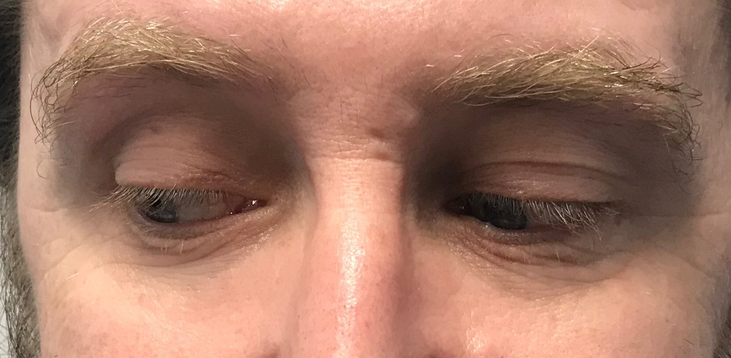
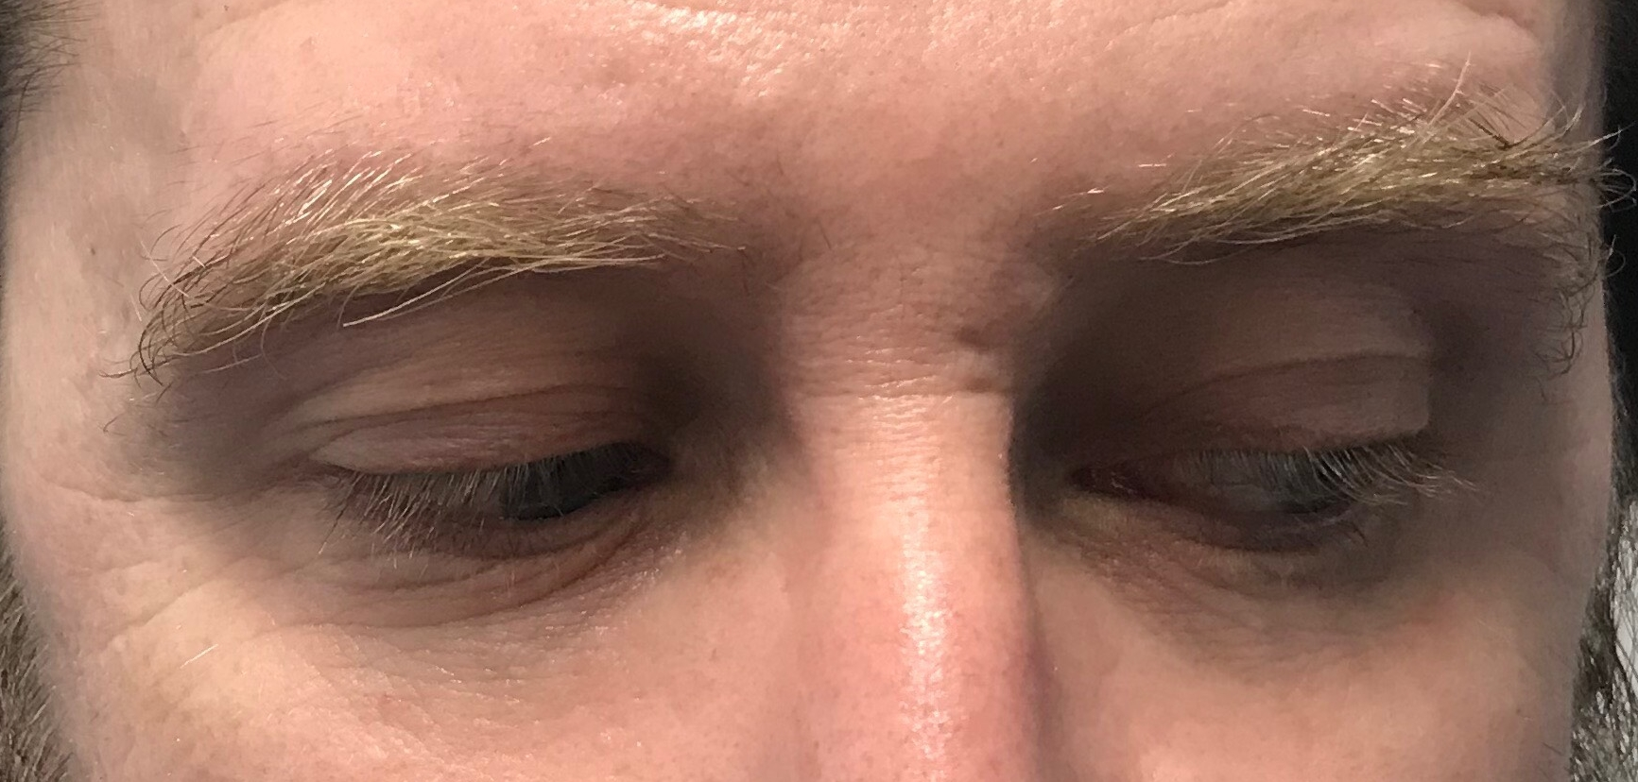
Lying Eyes
A glance to the observer's left usually reveals a creative process, when someone is "making up" facts or lying.
A glance to the observer's right reveals that the subject is remembering facts.
Here are some general patterns that you can use when talking to someone. It shows the various directions of eye movements of a person and explains what is usually going on in their mind at that moment.
Recalling an image
Dreaming up
an image
Imagining a sound
Remembering a sound
Remembering feelings and sensations
Internal dialogue going on
Notes:
Up and to the Left: Indicates a visually constructed Images. If you asked someone to "Imagine an ice cream sundae with a red cherry on top", this would be the direction their eyes moved. In their mind they are "Visually Constructing" an ice cream sundae with a cherry in their mind.
Up and to the Right: Indicates a Visually Remembered Images. If you asked someone to "What color shirt or blouse did you wear yesterday?", this would be the direction their eyes moved. In their mind they are "Visually Remembering" the color
To the Left: Indicates an Auditory Construct thought. If you asked someone to "Try and ceate the sound of a speeding train in your head", this would be the direction their eyes moved. In their mind they are imagining and creating the sound of a speeding train.
To the Right: Indicates an Auditory Memory. If you asked someone to "Remember what the National Anthem sounds like", this would be the direction their eyes moved in while remembering the song.
Down and to the Left: Indicates a Feeling / Kinesthetic / Sensory impression that is being created. If you asked someone to "Can you remember the taste of chocolate?", this would be the direction their eyes moved in while they recalled a smell, feeling, or taste of eating chocolate.
Down and To the Right: Indicates an Internal Dialog. This is the direction of someone's eyes as they "talk to themselves."

Slide 18
Body Language Gestures
ACTIVITY
Work with a partner and try acting out one or more of the following emotions:
CONFIDENCE
LYING
FEELING DEFENSIVE OR NERVOUS
BEING INTERESTED
Ask your partner to guess what emotion you are acting out. Then swop roles…

Slide 19


BUILDING RAPPORT
Rapport Building Behaviours
If you are sitting then lean forward, towards the person you are talking to, with hands open and arms and legs uncrossed. This is open body language and will help you and the person you are talking to feel more relaxed.
Look at the other person for approximately 60% of the time. Give plenty of eye-contact but be careful not to make them feel uncomfortable.
When listening, nod and make encouraging sounds and gestures.
Smile!
Use the other person’s name early in the conversation. This is not only seen as polite but will also reinforce the name in your mind so you are less likely to forget it!
Ask the other person open questions. Open questions require more than a yes or no answer.
Use feedback to summarise, reflect and clarify back to the other person what you think they have said. This gives opportunity for any misunderstandings to be rectified quickly.
Notes:
Rapport is a state of harmonious understanding with another individual or group that enables greater and easier communication. In other words rapport is getting on well with another person, or group of people, by having things in common, this makes the communication process easier and usually more effective.

Slide 20


BUILDING RAPPORT
Talk about things that refer back to what the other person has said. Find links between common experiences.
Try to show empathy. Demonstrate that you can understand how the other person feels and can see things from their point of view.
When in agreement with the other person, openly say so and say why.
Build on the other person’s ideas.
Be non-judgemental towards the other person. Let go of stereotypes and any preconceived ideas you may have about the person.
If you have to disagree with the other person, give the reason first then say you disagree.
Admit when you don’t know the answer or have made a mistake. Being honest is always the best tactic, acknowledging mistakes will help to build trust.
Be genuine, with visual and verbal behaviours working together to maximize the impact of your communication.
Notes:
Rapport is a state of harmonious understanding with another individual or group that enables greater and easier communication. In other words rapport is getting on well with another person, or group of people, by having things in common, this makes the communication process easier and usually more effective.

Slide 21
MIRRORING
ACTIVITY
Find a partner in the room, preferably someone you don't know very well or don't work with often…
Notes:
Description:
Tell everyone to find a partner in the room, preferably someone you don't know very well or don't work with often. Decide who is A and who is B. You will face your partner and an easy way to begin is to stand with your palms open and facing each other but not touching. Instruct the pairs that when you say Go, A will begin to move and B will follow or mirror the movements of A. Instruct them that the point is to move slowly and precisely, so that you would have trouble telling who is leading and following. Tell them to keep eye contact, don't look at the hands or any other part that is moving.
Tell them after a little while you as the facilitator will call out SWITCH. When that happens then B is the leader and A is the follower. This should be a fluid transition. Eventually there is no way to tell which player is leading the exercise. The focus is being shared rather than taken by one player or the other.
Tips:
Time it. I usually give 2 minutes. - When explaining how it is played pull someone up with you and show how it is done. You be the leader. - When explaining the that the purpose is not to try and mess up your partner, you can make real big, fast and crazy moves so that the volunteer who is your demo partner can't keep up. Usually gets a laugh. - When explaining about calling out Switch! make sure you say only you as the facilitator will call Switch.
Discussion:
Usually at the end there is clapping or laughter or sighs of relief. Wait for that to die down and then ask them, "So, what did you think?" “How did it go?” “How did you feel?”

Slide 22

MIRRORING
Mirroring can create ‘good energy’ between people, makes people feel comfortable and can help conversations flow…

Slide 23
PRESENTING A POSTIVE IMAGE AND YOUR PERSONAL BRAND
HOW YOU SEE YOURSELF
YOUR PERSONAL BRAND
HOW OTHERS SEE YOU
How do you want people to remember you?
How would you want to be described by someone else?
What are your best features and what are you really great at?
YOUR BRAND
Discussion Question:
How are you presenting your ‘personal brand’ on social media, on the phone, in emails, in written communication and in person?
What needs to change (if anything)?
Your
IMAGE
Your
MISSION
Your
VALUES
Your
VISION

Slide 24
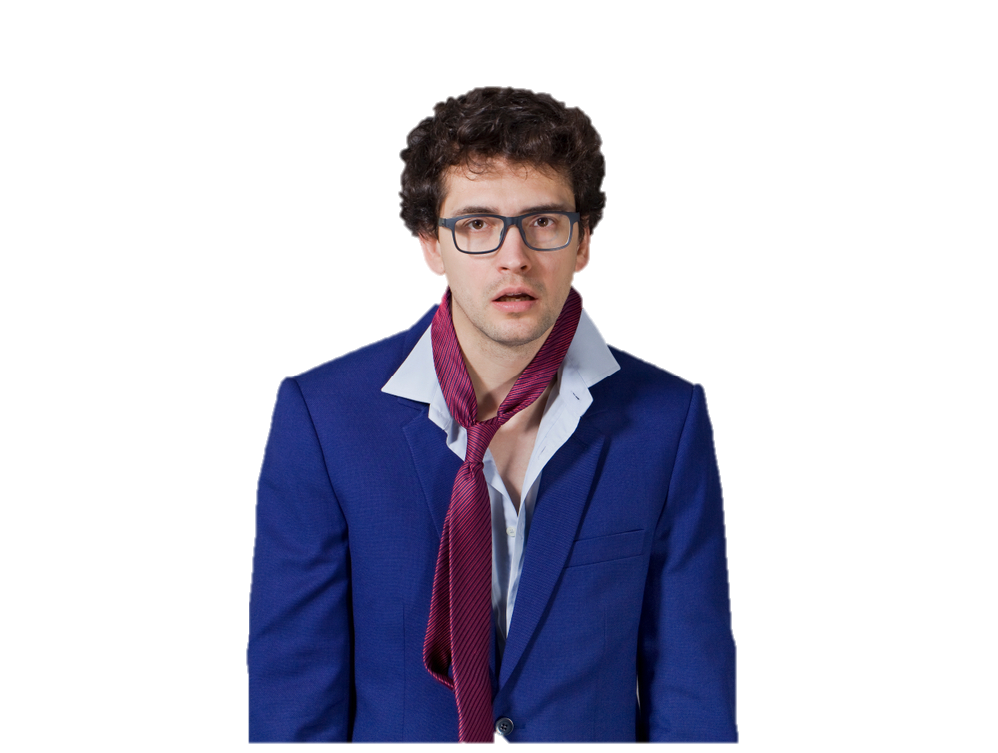
Tips on Presenting a Positive Image at Interviews
Consider the job interview a serious and formal sales opportunity; therefore, completely avoid any type of informal, casual, or leisure dress.
Dress neatly and tastefully, avoiding radical styles and bright colours.
Wear clothing that complements you and accentuates your strengths, and not clothing that is distracting and pretentious.
Make certain that clothing and accessories are well coordinated.
Dress appropriately. Understand the climate and dress code of your field. Is it a very serious climate with a highly conservative dress code or a lighter climate with a leaning toward *'in" or fashion-oriented dress?
Discussion Questions:
What type of job are you going for?
What does a successful professional in this type of job look like? How would you describe them?

Slide 25
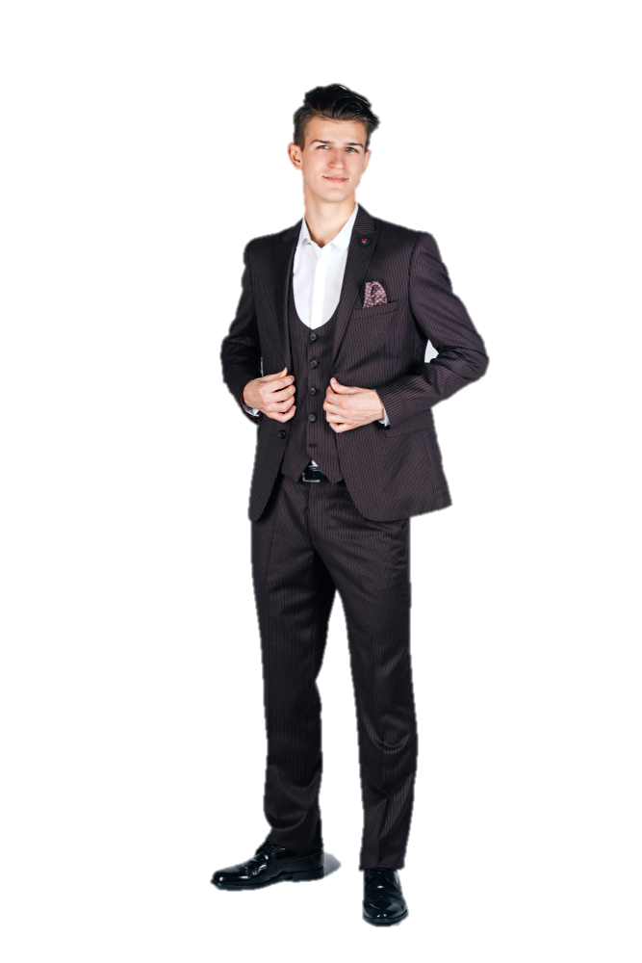
Tips on Presenting a Positive Image at Interviews-BE Appropriate
Dress the role. Help the interviewer visualize you in the job and the company by wearing the quality clothing you can be expected to wear if hired. See how other successful people in this and similar positions dress. Read professional magazines, attend meetings, and always remember to watch styles of dress. Your goal is to make the interviewer think, 'This person looks as if she would fit in well.
Dress successfully. If you want the interviewer to think you are successful and that you care about quality, then pay a little more for the attire you wear during the interview. Remember, there is no way you can buy quality appearance with a bargain-priced suit—when it comes to clothing, good quality is apparent. Furthermore, make sure your clothing is properly fitted; have your outfit tailored if you must. Even the most expensive suit will look goofy if it doesn’t fit properly, while a relatively cheap fitted one can make a great first impression.
Would this look work for a job interview on a construction site?
Discussion Questions:
How will you dress for an interview for the type of job you want to get so you look appropriate and will fit in well with the company?

Slide 26
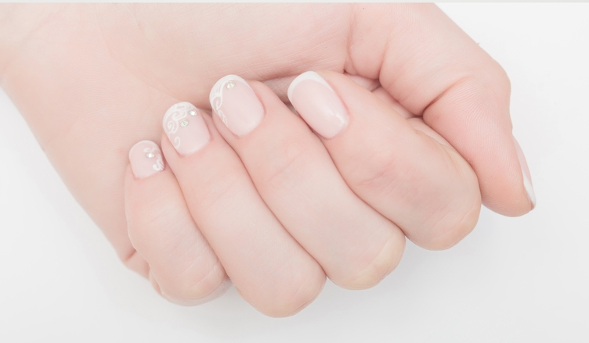
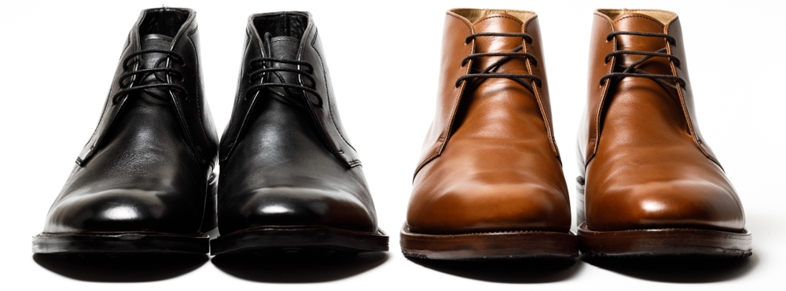
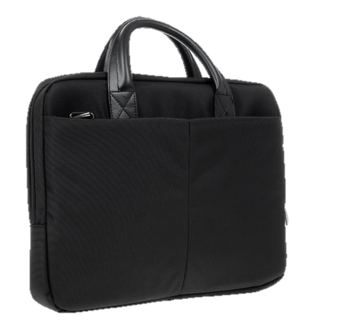


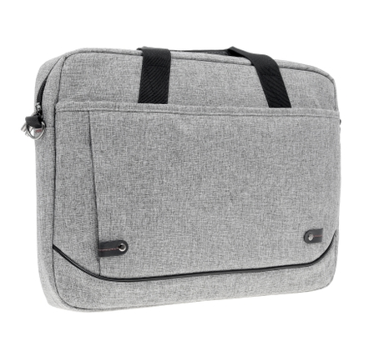
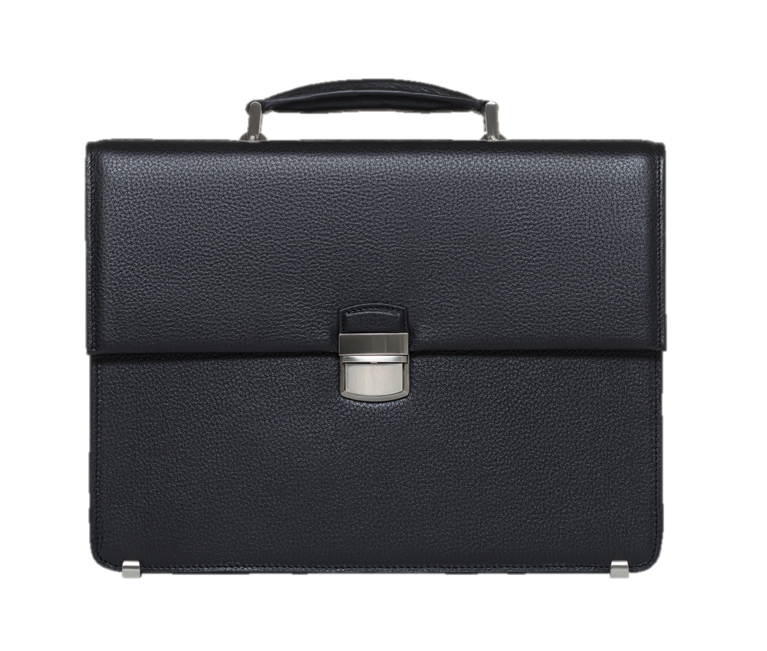
Tips on Presenting a Positive Image at Interviews-good Grooming
Be well groomed. This means shined shoes, manicured nails, appropriately cut and styled hair, clean shaven face, fresh-smelling breath, and clean-smelling body, scented with light deodorant. Avoid strong perfumes and colognes, as you never know how an interviewer will react to a certain scent. No matter how well you dress, if you step into the office with scuffed shoes, extend nail-bitten hands, talk with smoker's breath, and emanate offensive body odour, or reveal a head of scraggly hair, the interviewer will not take you seriously.
If appropriate carry a small, business-looking case or briefcase to your interview. In addition to serving as a case for important job-getting documents and writing paper, this adds to your professional image.

