Slide 1



LIFE LONG LEARNING
The “MiGreat Project”- n. 2016-1-IT01-KA202-005348 has been funded with support from the European Commission. This document reflects the views only of the author and the Commission cannot be held responsible for any use which might be made of the information contained herein.

Slide 2
LIFE LONG LEARNING
How can lifelong learning be structured?
Step 1
Define and structure the path you want to travel and goals you want to achieve.
The “MiGreat Project”- n. 2016-1-IT01-KA202-005348 has been funded with support from the European Commission. This document reflects the views only of the author and the Commission cannot be held responsible for any use which might be made of the information contained herein.

Slide 3
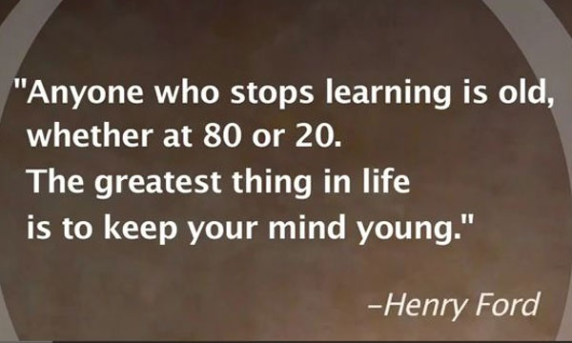

Slide 4
LIFE LONG LEARNING
How to enrol into CVET?
Step 2
Find the information required and steps to be taken in order to enroll into courses that are useful for professional development.
The “MiGreat Project”- n. 2016-1-IT01-KA202-005348 has been funded with support from the European Commission. This document reflects the views only of the author and the Commission cannot be held responsible for any use which might be made of the information contained herein.

Slide 5
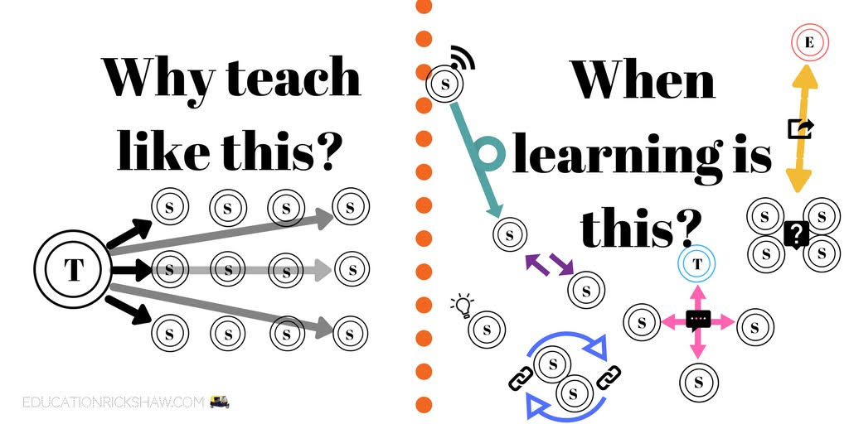

Slide 6
LIFE LONG LEARNING
How to get your qualifications recognised?
Step 3
Another important aspect is to know how qualification taken abroad can be recognised in the new country. This step helps to prepare for continuing education and entering the labour market.
The “MiGreat Project”- n. 2016-1-IT01-KA202-005348 has been funded with support from the European Commission. This document reflects the views only of the author and the Commission cannot be held responsible for any use which might be made of the information contained herein.

Slide 7


Slide 8
LIFE LONG LEARNING
Finding information?
Step 4
How to create an overview of existing sources and institutions that support professional development with education, funding in your chosen branch
The “MiGreat Project”- n. 2016-1-IT01-KA202-005348 has been funded with support from the European Commission. This document reflects the views only of the author and the Commission cannot be held responsible for any use which might be made of the information contained herein.

Slide 9
